Slide 1
5-2. Supervised learning
Youngsoo Kim <pineland@hanmail.net>
Code : https://github.com/pineland/AIDA/

Slide 2
Contents
Supervised learning concepts
Classification algorithms
Overfitting & Underfitting
Evaluation of performance
Problem of imbalanced data

Slide 3
Computer learning methods
Unsupervised Learning
Clustering
Semi-Supervised Learning
Supervised Learning
Reinforcement Learning

Slide 4


Supervised learning
Definition
Learn the computer using a given data(input, output).
Find a way to determine the results when a new input comes.
Classification
The output is determined into one of the classes.
Regression
The output is determined into the value of the continuous area.
$$\left\{{(x}_{1},y_{1}\right),{(x}_{2},y_{2}), …,{(x}_{n},y_{n})\}$$
$$y=f(x)$$

Slide 5
Classification algorithm
A sort of Classification algorithms
K-nearest neighbor (KNN) algorithm
Decision tree algorithm
Naive Bayesian algorithm
Support vector machine (SVM)
AdaBoost
Random forest
Probabilistic graphical model
Deep learning

Slide 6
Classification algorithm
Ideal classification algorithm (classifier)
is good at classifying data that is not used in learning.
Dataset
training data
A set of data used to learn the classifier.
test data
A set of data used to evaluate the performance of a learned model.
validation data
A set of data used to determine when to discontinue learning in the course of the learning process

Slide 7
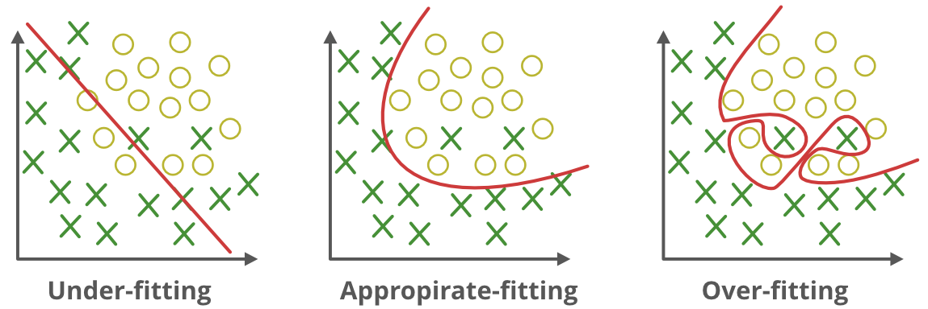
Overfitting & Underfitting
Overfitting
Excessively learned status for learning data
Because data is highly likely to contain errors or noise, very high performance for learning data can be poor performance for unlearned data.
Underfitting
Not learn enough learning data

Slide 8
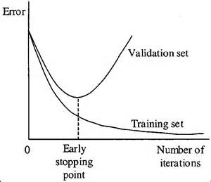
Overfitting & Underfitting
How to avoid overfitting ?
Use big data
Regularization (generalization)
Evaluate Performance “using a validation data” during the learning process.
Stop learning when errors on verification data are decreasing and increasing.

Slide 9
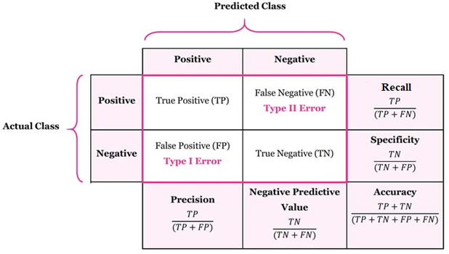
Evaluation of performance
Performance evaluation of a classifier
Accuracy : # of correctly classified data / total # of data
Confusion matrix
allows easy identification of confusion between classes.
Notes:
* https://adnoctum.tistory.com/981?category=314594

Slide 10
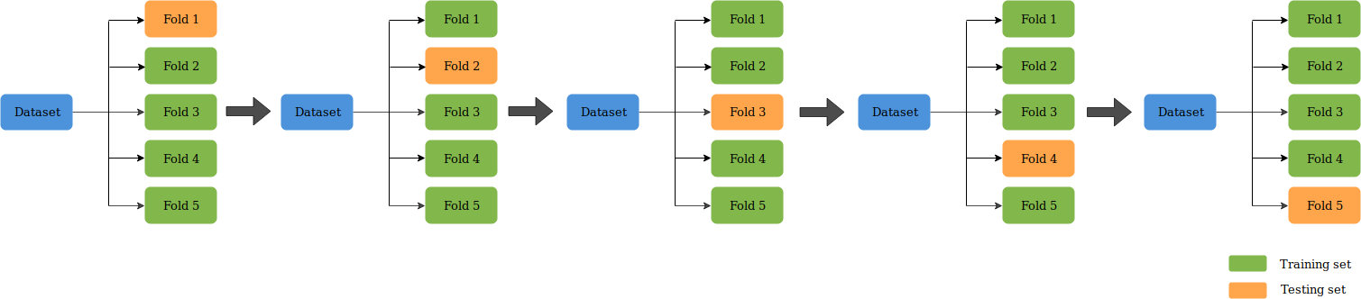
Evaluation of performance
It is recommended to ”use a lot of data” to ensure that the classifier has good accuracy.
However, it is not easy in reality.
Performance evaluation with insufficient data
Inefficient to obtain test data separately
k-fold cross-validation

Slide 11
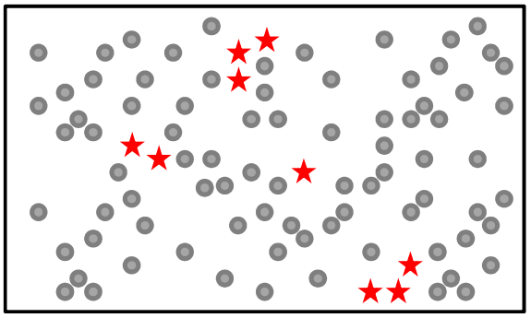
Problem of imbalanced data
Occurs when the number of learning data belonging to a particular class is too large compared to other classes
e.g.) If the class A data is 99%
of the total, the accuracy
is 99%, even if the output
of the classifier is always A.
Countermeasures
Use of a weighting accuracy scale
Re-sampling in classes with a large number of learning data
Artificial data generation for classes with less learning data

Slide 12

Q & A

